Slide 1
Supporting presentation for lecturers of Architecture/Civil Engineering
Chapter 10
Forms and availability

Slide 2
Why « Forms and Availability » ?
Delivery times and costs are major issues for architects & civil engineers
While all stainless steel products start from a melting shop
There are many processing routes for stainless products
And stockholders, traders providing service packages
And therefore Delivery times and Costs may vary widely

Slide 3
Some background information How stainless steel is produced
Video: Steelmaking and Hot Rolling of coils
Video: Hot Rolling of coils
Video: Cold rolling of coils
Video: Steelmaking and hot rolling of bars
Video: Wire rod rolling
Video: Wire rod rolling

Slide 4
Stainless Steel Supply Chain
Stainless Steel Mill
Ex-mill sales
Distributors
(of which mill-owned)
SIMPLIFIED
Products
Coils, Sheets, Plates
Bars, Wire
Reinforcing bar
Customized:
Cut to length
Cut to shape
Polishing …
Fabricators
+
Specific finishes (such as color)
Service
Minimum weight 1 slab
Production on order
Lead time 2 – 3weeks
Lowest price /Kg
Small orders
Available from stock
Short delivery times (1-3 days)
Price premium for service
Stainless Steel Mill
Standard Component Manufacturing
Distributors
(of which mill-owned )
Products
Service
Fasteners
Tubes
Valves
Fittings
Available from stock
Short delivery times (1-3 days)
Price premium for service

Slide 5
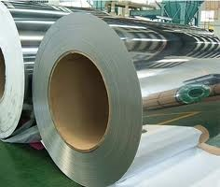
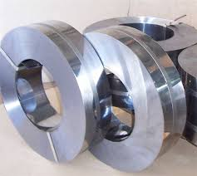
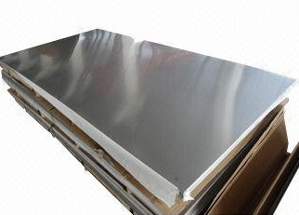
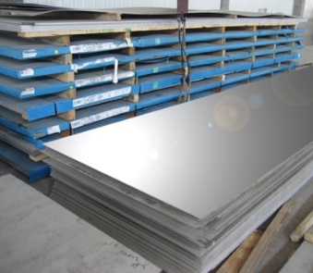
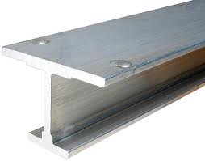
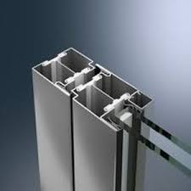
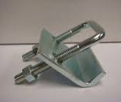
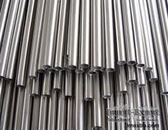
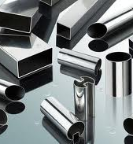
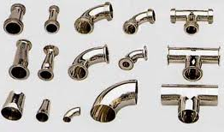
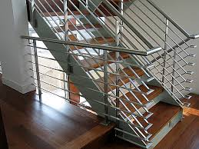
Flat products
Ex-mill |  |  | Custom
Cold-rolled coil | Cold-rolled strip | Cold-Rolled polished sheet | Laser cut shape
Plates | I-beam from plate | Door & Window profiles | Clamps
Standard tubes | Profiled tubes | Tube fittings | Railings

Slide 6
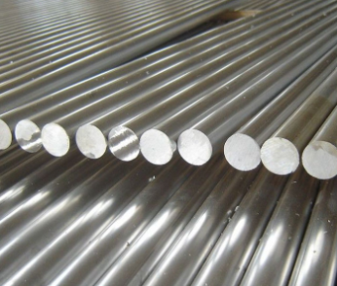
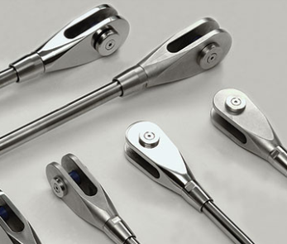
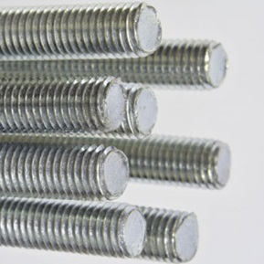
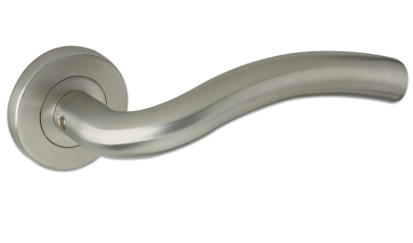
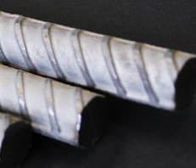
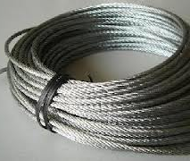
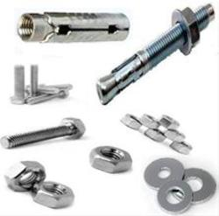
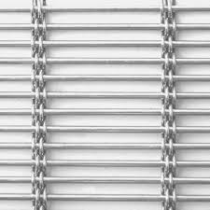
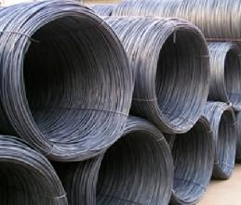
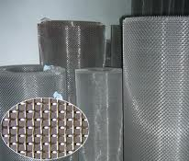
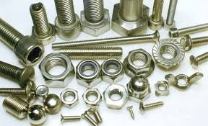
Long Products
Ex-mill |  |  | Custom
Bars | Tie-bars | Threaded bars | Handles
Reinforcing Bar | Cables | Concrete Anchors | Sunbreaker
Wire Rod | Mesh | Fasteners | Mesh shower curtain

Slide 7
Future trends
The urgency of climate change mitigation and of a sustainable economy will drive major changes in the years to come.
A new product offer is likely to appear:
re-conditioned products. Stainless steel from buildings/ facilities being de-constructed could be re-processed and made available for a new service life without loss of properties.
Higher strength and thinner products, able to offer the same service performance with less material use. The development of lean duplex grades and of cold-worked austenitic grades is already taking place.

Slide 8
References
Major stainless steel producers https://www.worldstainless.org/about-issf/issf-members/

Slide 9
Thank you
Test your knowledge of stainless steel here:
https://www.surveymonkey.com/r/3BVK2X6

